Slide 1
Regional Food System Partnerships Program (RFSP)
Reviewer Training
August 5, 2025

Slide 2





Agenda
Program Overview
Project Types
Review Process
Evaluation Criteria
Review Timeline

Slide 3
What is the Regional Food System Partnerships Program?
Authorized by the 2018 Farm Bill as part of the Local Agriculture Market Program (LAMP)
  Supports the development, coordination, and expansion of local and regional food systems through public-private partnerships.
  Supports the development and implementation of plans, studies, and strategies to address needs within the local and regional food system infrastructure.
  Strengthens local and regional food system capacity and resilience through community collaboration.

Slide 4
Unique Qualities of RFSP
PARTNERSHIP grants, not focused on a single entity simply ‘collaborating’ with others.
Role of the lead applicant is to administer the award.
Partnership proposes a definition of ‘region’ as part of the application process, including defining geographic parameters.
Funding is intended to support partnership-level activities devoted to a shared vision or set of goals (including efforts to identify and assist in accessing additional resources on behalf of eligible partnership members).

Slide 5
RFSP Project Types
Project Type | Amount | Duration | Activity Examples
Planning & Design | $100,000-$250,000 | 24 Months (2 Years) | Convening established and new partners to define the regional food system scope and structure. Creating and conducting feasibility studies. Connecting value chain entities with partners and funders to strengthen the regional food system.
Implementation & Expansion | $250,000- $1,000,000 | 36 Months (3 Years) | Prioritizing strategies to fill food systems gaps. Institutionalizing processes for ongoing community and business engagement. Identifying resources, providing technical assistance, and applying for programs and resources.

Slide 6

RFSP Project Types Continued
RFSP Project Types
More information and examples for RFSP Project Types can be found in the RFSP RFA and on the RFSP Program Website

Slide 7








Review Process Overview
Teams of three
Approx. 6-7 applications by grant type
Individual score and comments
Deadline of individual reviews
Panel chair will organize team members
Consensus score and comments
Deadline of consensus review

Slide 8
Conflict of Interest/Confidentiality
Reviewers are not allowed to review for a program that they are also applying for (as the applicant or as a partner).
Let us know immediately if you discover a conflict of interest.
Please do not discuss any details of the applications or the review process outside of your team.
All printed materials and electronic materials must be shredded or deleted at the conclusion of the review process.
You should NOT contact the applicant at any time.

Slide 9
Reviewer Tools
ARM System Manual
RFSP Reviewer Manual
Request for Applications (Scoring Criteria in Section 6) and Project Narrative form
Scoring Matrix
AMS Reviewer Webpage

Slide 10
Reviewer Responsibilities
Reviewer
  Spend some time at the beginning reviewing the materials that are provided (Manuals, RFA, Criteria/Scoring Elements), to get an idea for what you will want to watch out for during your reviews.
  Provide comments as part of the individual review.
  Ensure comments correspond with the scores and are substantive, constructive and helpful.
  Actively participate during the consensus discussions.
  Meet deadlines established by AMS and panel chair.

Slide 11
Chair Responsibilities
Panel Chair
  Guide team members to ensure deadlines are met.
  Communicate with your team as soon as possible about how the team will work together and get to know each other.
  Facilitate consensus review discussion for each application.
  Ensure provided comments focus on strength, weaknesses and suggestions to improve.
  Ensure consensus comments and scores reflect the panel team, not personalized comments.
  Ensure team members have an opportunity to present their views.
  NEW - Complete the Summary Statement (More information at the end of this PowerPoint)

Slide 12
Evaluation Criteria

Slide 13
Scoring Matrix Alignment & Intent - 25 pts
CRITERIA | EXCELLENT | VERY GOOD | GOOD | FAIR | POOR
Score → | 21 – 25 | 15 – 20 | 8 – 14 | 1 – 7 | 0
Details → | Essentially no deficiencies. Strong, convincing justification. Contains a concise, well-conceived problem/issue statement. The objectives are precise, attainable, and meet the purpose of the grant program and will significantly benefit stakeholders. | Slight deficiencies. Convincing justification. Contains a very good problem/issue statement. The objectives fit the intent of the grant program and impact the intended beneficiaries. | Minor deficiencies. Adequate justification and problem/issue statement. The objectives generally align with the purpose of the grant program, but there is room for improvement in the level of detail provided. Project has the potential for successfully benefitting the region and the intended beneficiaries. | Several deficiencies in basic aspects of the project. Includes a justification and problem/issue statement but could have been better stated. The ideas are not well-developed and may not be feasible to support a successful project or significantly impact the beneficiaries. | Major deficiencies in one or more aspects of the project. Fails to make a case for the project. The project does not fit the intent of the grant program. Required sections or details are missing.
Notes:
Suggested Alignment and Intent questions to consider. What are the strengths and weaknesses?
• Does the proposal have a clear and concise description of the specific issue, problem, or need, and project objectives? RFA 1.2 Purpose
• Does the project adequately demonstrate how it meets the purpose of RFSP?
• Does the proposal describe who the intended beneficiaries are and how they will benefit including the estimated number of beneficiaries?
• Does the application comply with all instructions in the RFA and Project Narrative (fit within page limit, include all required documents, meet match requirements, etc.)?

Slide 14
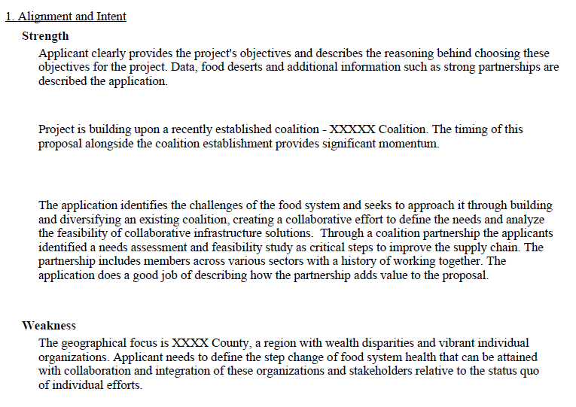
Alignment and Intent

Slide 15
Scoring Matrix Technical Merit - 25 pts
CRITERIA | EXCELLENT | VERY GOOD | GOOD | FAIR | POOR
Score → | 21 – 25 | 15 – 20 | 8 – 14 | 1 – 7 | 0
Details → | Essentially no deficiencies. Clear, well-described, focused, feasible plan and methodology with proper resources. The methodology is suitable and feasible. A clear plan is articulated, including a clear timeline to complete all objectives. If applicable, the proposed project builds on previous partnership work or activities and lessons learned to successfully meet goals. | Slight deficiencies, but overall, a solid project. Project is feasible, personnel and partnerships are appropriate, and timeframe is doable. If applicable, the proposed project builds on previous partnership work or activities and lessons learned to successfully meet goals. | Minor deficiencies. Would benefit from more detail or a stronger focus. The project’s work plan/approach generally outlines the applicant’s goals and intent, but there is room for improvement as far as specificity of the work and/or the timeline. If applicable, the proposed project builds on previous partnership work or activities and lessons learned to successfully meet goals. | Several deficiencies. Omits discussion of one or more relevant aspects of the work plan, or personnel. If the applicant proposes to build upon previous partnership activities, the currently proposed project does nothing to build off past success and lessons learned. | Major deficiencies. Vague and confusing work plan. Unclear who is responsible for the project. Timeframe difficult to understand, unrealistic or not discussed. Required sections or details are missing.
Notes:
Suggested Technical Merit questions to consider. What are the strengths and weaknesses?
• Is there a clear and well-conceived plan to fulfill the goals and objectives of the project, including activities, timeline, and resources and responsibilities for partners?
• Is the timeline reasonable based on the planned activities? Does it clearly outline how the partnership will meet the intended goals and objectives?
• For a Planning/Design proposal, does the application provide a clear plan for recruiting and convening a diverse group of potential partnership members? For an Implementation/Expansion proposal, does the application include a description of how the project will build upon previous efforts?

Slide 16
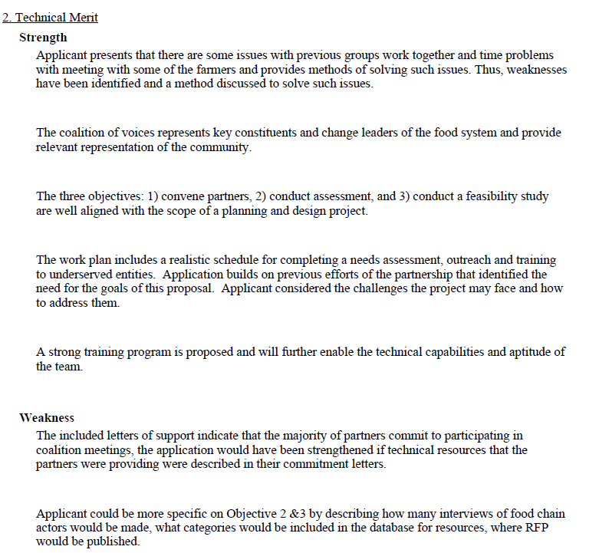
Technical Merit

Slide 17
Scoring Matrix Achievability - 15 pts
CRITERIA | EXCELLENT | VERY GOOD | GOOD | FAIR | POOR
Score → | 21 – 25 | 15 – 20 | 8 – 14 | 1 – 7 | 0
Details → | Essentially no deficiencies. The proposed project is extremely likely to succeed based on its goals, objectives, and selected performance measures. The applicant has an exceptionally detailed plan to evaluate the work and collect feedback to achieve each relevant objective. The challenges discussed are realistic and the strategies to address them appear well- defined and practical. Outcomes and indicator(s) are appropriate for the scale and scope of the project. | Slight deficiencies. The proposed project is likely to succeed based on its goals, objectives, and selected performance measures. The applicant has a solid plan to evaluate the work and collect feedback to achieve each relevant outcome indicator(s). The challenges discussed are realistic and the strategies to address them are adequate. Outcomes and indicator(s) are mostly appropriate for the scale and scope of the project. | Minor deficiencies. The proposed project may succeed, but it is difficult to tell what degree. The applicant’s evaluation plan needs improvement. The challenges discussed may be realistic and the strategies to address them relevant. The applicant could improve their plan to disseminate results of their work. The applicant could strengthen outcomes and indicator(s). | Several deficiencies. The proposed project is unlikely to succeed, and the work has been done before. There are few details regarding an evaluation plan. The challenges discussed are not realistic and the strategies to address them may not be adequate. The applicant does not have a clear plan to disseminate results, their outcomes and indicator(s) are few or are unclear. | Major deficiencies. The proposed project cannot fulfill its goals, objectives, and selected performance measures and the work is unoriginal. Required information and details are missing.
Notes:
Suggested Achievability questions to consider. What are the strengths and weaknesses?
• Are the Outcomes and Indicators appropriate for the scale and scope of work proposed?
• Has the applicant selected at least one Outcome and corresponding Indicator (as required)? If the applicant provided an ‘Optional” outcome for Outcome 4? Was the outcome described and was at least one corresponding Indicator described to measure progress towards that outcome?
• Does the application adequately describe a monitoring and evaluation plan for the project?
• Did the applicant describe any anticipated key factors that may restrict progress toward the selected Indicators, and action steps for addressing these factors? Is the Partnership ready to start and perform the described work immediately upon award receipt?
• Does the application describe how the partnership plans to continue beyond the grant’s period of performance?

Slide 18
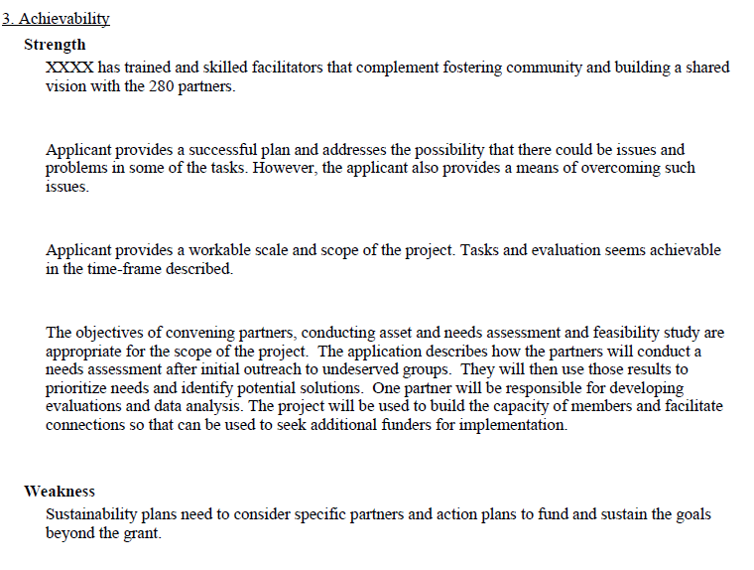
Achievability

Slide 19
Scoring Matrix Expertise & Partners - 25 pts
CRITERIA | EXCELLENT | VERY GOOD | GOOD | FAIR | POOR
Score → | 21 – 25 | 15 – 20 | 8 – 14 | 1 – 7 | 0
Details → | Essentially no deficiencies. The applicant has clearly articulated the project’s management plan and partnerships. The project’s key participants are diverse and well-qualified to work on local and regional agricultural activities, and their past performance illustrates that they can fulfill their obligations. Partners are actively engaged in the project and have a vested interest in helping fulfill the project’s activities and outcomes. All participants are actively committed to communicating the results of the project to ensure success beyond the life of the grant. | Slight deficiencies. The applicant has articulated the project’s management plan and partnerships. The project’s key participants are mostly diverse and qualified to work on local and regional agricultural activities, and they can fulfill their obligations. Partners are engaged in the project and have an interest in the applicant fulfilling the project’s activities and outcomes. Participants are committed to communicating the results of the project to help sustain success beyond the life of the grant. | Minor deficiencies. The management plan and partnerships are not extraordinary, and the diversity and qualifications of key participants could be strengthened. Roles of partners are mentioned, but it’s not entirely clear what role they will play in the project beyond achieving individual success. There is no clear indication that the partners will help communicate the project results to help sustain the project beyond the life of the grant. | Several deficiencies. The management plan and partnerships are severely lacking, or the qualifications of key participants are insufficient. There are few partnerships and if provided at all, are tangential or not included in the work plan/ approach. There is little to no plan to communicate the project results and there seems to be little interest in sustaining the project beyond the life of the grant. | Major deficiencies. There is no management plan and no mention of partnerships or cooperative linkages. There is no plan to communicate the project results and no mention of sustaining the project beyond the life of the grant. Required information and details are missing.
Notes:
Suggested Expertise & Partners questions to consider. What are the strengths and weaknesses?
• Are letters of commitment in place from all partner organizations?
• Is the partnership substantial and diverse enough to accomplish the project’s goals and objectives?
• Do the partners have sufficient overall experience to successfully implement the proposed project?
• Does the application demonstrate a commitment to engage potential project beneficiaries as active participants in activities?
• Does the application describe plans for coordination, communication, data sharing, and reporting among members of the partnership and other stakeholder groups?

Slide 20
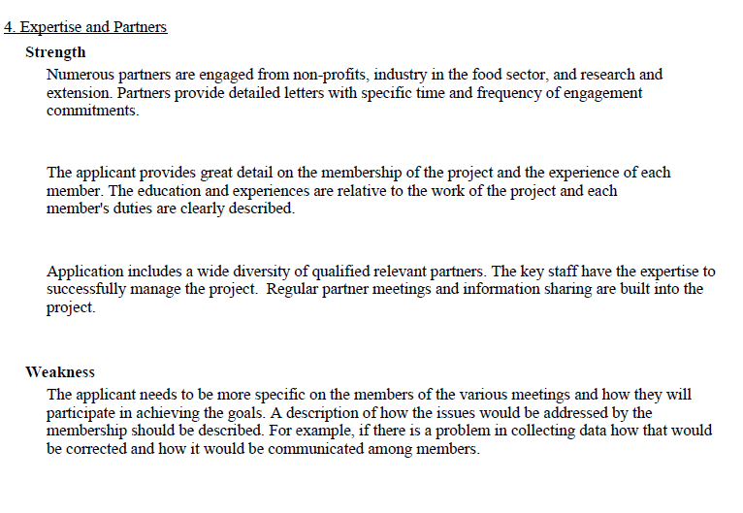
Expertise and Partners

Slide 21
Scoring Matrix Fiscal Plan & Resources - 10 pts
CRITERIA | EXCELLENT | VERY GOOD | GOOD | FAIR | POOR
Score → | 21 – 25 | 15 – 20 | 8 – 14 | 1 – 7 | 0
Details → | Essentially no deficiencies. Budget clearly correlates to each project objective and accounts for all proposed activities. All items are allowed and reasonable. The overall budget is fully appropriate for the scope of the project. Stated infrastructure competently exists and will allow the project to start and be completed on solid footing and will even sustain the project beyond the grant’s performance period. Letters of matching funds verify funding sources and demonstrate how valuations were established. | Slight deficiencies. Budget largely correlates to each of the project objectives and accounts for all major proposed activities and most minor proposed activities. All major items and most minor items are allowed and reasonable. The overall budget is appropriate for the scope of the project. Stated infrastructure exists and will allow the project to start on solid footing. Letters of matching funds verify funding sources, if not all funding sources, and demonstrate how valuations were established. | Minor deficiencies. Budget may not consistently correlate to each project objective, but project goals will likely be met. Most major and minor items are allowable and reasonable. The overall budget is generally appropriate for the scope of the project. Stated infrastructure is appropriate but may not be sufficient to solidly start/complete the project. Letters of matching funds verify most funding sources and demonstrate how valuations were established. | Several deficiencies. Budget does not correlate well to the project. Some major and multiple minor items are not allowable and/or reasonable. The overall budget request may be over or underestimated for the scope of the project. Stated infrastructure are inadequate to insure on-time start of the project and weaken chances of success. Letters of matching funds cannot be clearly verified sources or demonstrate how valuations were established. | Major deficiencies. Many serious shortcomings in the budget. Many items are clearly not allowable and/or reasonable. There is no correlation between the budget and the project objectives. The overall budget request is significantly either too large or too small for the scope of the project. Required information and details are missing.
Notes:
Suggested Fiscal Plan and Resources questions to consider. What are the strengths and weaknesses?
• Is the budget consistent with the size and scope of the project narrative? Are there elements in the project narrative not included in the budget, or vice versa?
• Are the planned expenditures in the budget clearly described, reasonable, and necessary for the success of the project?
• Has the applicant provided the required match letters for each match source listed in the application, and do those letters accurately correspond to the match resources described in the application’s budget?

Slide 22
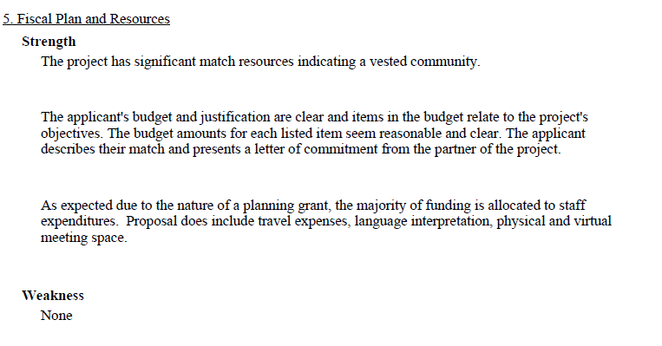
Fiscal Plan and Resources

Slide 23
Reviewer Comments
When writing comments, avoid mixing +/- language within a single comment
  For example: “The applicant provided a well-constructed work plan, but did not describe the role of each partner in the project”
In general, if a particular section/criterion on the consensus report has more strengths than weaknesses listed, the numerical score for that section should be above 50%, or vice versa
Avoid using personal pronouns in comments such as “I” or “we”. Instead, use “the panelist” or “the reviewers”
Ask yourself: ‘Would I find this comment useful if I was the applicant?’

Slide 24
Reviewer Comments Continued
Reviewer Comments
Use complete sentences with correct grammar and spelling. Reports with these types of mistakes will be returned for corrections and will delay the overall process significantly.
Be extra careful of ‘false friend’ words that pass “spell check” (i.e., “moat” vs. “most”, “has” vs. “had”, “country” vs. “county”, etc.)
Avoid using quotation marks, or special characters or formatting (such as bullets) in your comments
Panel Chairs: Try to consolidate individual reviewer comments when writing the comments for the Final Summary Report
  For example, don’t list “The budget is appropriate for the scope of the project and all items are allowable and reasonable” and “Requested items are allowed and reasonable” as two different strengths for the Fiscal section.

Slide 25
Weak Comments vs Adequate Comments
WEAK COMMENTS | ADEQUATE COMMENTS
The workplan details seems doable. | The work plan details the activities necessary to develop the framework to support purchasing of local food and then facilitate implementation to the regional school districts in a fully integrated statewide network.
The dissemination plan is virtually non- existent. | The application does not provide a plan to disseminate results or communicate to stakeholders.
The timeline is too ambitious. | The timeline in the work plan included many activities and was too ambitious. For example, at the start of the project, training was conducted with farmers to sell produce at the market and develop business plans and by the end of the one-year project, equipment was being purchased to assist farmers in establishing a business to process the produce.

Slide 26
Scoring Reminders
No two applications reviewed by your panel may have the same score.
The individual scores by panelists for each evaluation criterion must fall within a 10-point range to ensure consistency and alignment in the review process.
  Double-check that your scores align with the narrative comments.
  Ensure the ratings reflect the strengths and weaknesses identified.

Slide 27
Tips
Don’t wait until the deadline is approaching to start working; submitting earlier in the timeline makes it easier for clearing through the approval pipeline.
Don’t do all the reviews in one big time block; create a break time between reviews to stay fresh.
Remember you can’t edit something once you submit it into the approval pipeline; it needs to be returned to you.
Length of consensus discussion depends on variance between individual reviewer scores, and comments; the bigger the variance, the longer the team may need to discuss a specific application.

Slide 28
Review Timeline
Activity | Dates
Mandatory Orientation Training ARM Training and RFSP Grant Review | August 5, 2025
Arm Session Opens for Reviews | August 7, 2025 – 6 PM (ET)
Office hours for Chairpersons and Reviewers | August 12, 2025 – 1 PM (ET)
Comments and Scores for Applications 1 - 3 due in ARM | August 14, 2025, by 3:00 PM (ET)
Comments and Scores for Applications 4 -6 due in ARM | August 20, 2025, by 3:00 PM (ET)
Reviewers submit to Panel Chair scores and comments for Application 7 | August 20, 2025, by 11:59 PM (ET)
Panel Manager Feedback and Application Resubmissions (if applicable) for applications 1 - 7 | August 23 – August 27, 2025
All Comments and Scores due in ARM | August 27, 2025, by 3:00 PM (ET)
ARM Closes | August 28, 2025, 5:00 pm (ET)

Slide 29

Questions and Answers

Slide 30
Contact Information
ARM Questions:
USDAReview@grantreview.org
Program Questions:
IPPGrants@usda.gov
RFSP Review Support Page:
http://new.grantreviewinfo.net/usda1/fy23-usda-agricultural-marketing-service-ams-regional

Slide 31
RFSP Panel Chairs Training: Writing a Summary Statement

Slide 32
Summary Statement
This section is NEW and must be completed by the chairperson
The chairperson must provide a well-composed narrative statement (i.e. 2 - 4 paragraphs) summarizing the content of the Panel Summary Report. This summary should include:
  An overview of the applicant's proposed project;
  Statements highlighting the project's goals and objectives and how these goals align with the funding announcement; and
  Statements highlighting the overall merits and deficiencies (i.e. as presented in the report's strength and weakness statements).
  The summary should be written in "one-voice" and should clearly and concisely support the overall application score.

Slide 33
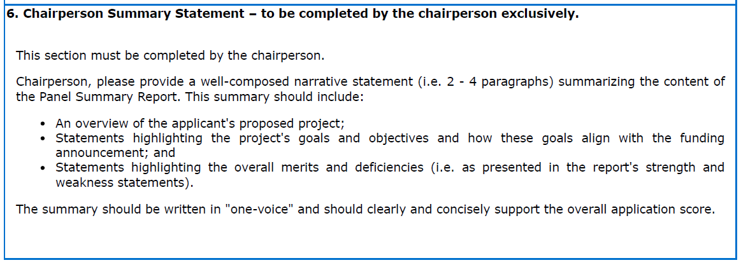
Summary Statement Criteria in ARM

Slide 34
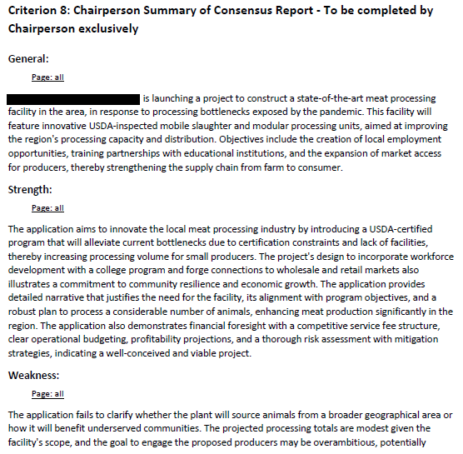
Chairperson summary consensus report

