Slide 1
Shiphold Stowage Exams in Pictures
Act / acg training
Pictures
Notes:
INSERT NOTES HERE

Slide 2
Objectives
This presentation will give you an orientation for Stowage Exams on Ships

Slide 3
Prior to Boarding
Make sure you park your vehicle a safe distance from the ship to avoid ropes and gangway mishaps.
Check to see if the yellow Quarantine flag is flying. If it is, enquire if the ship has been passed.
Take note of the spelling of the ship.
Make sure you have your Personal Protective Equipment PPE on (Helmet, Safety Shoes, Reflective Vest, Gloves). Also carry a scraper and flashlight.
Make sure you have your Government ID (LincPass).
Have all the paperwork necessary for an Inspection. This includes a pen, Bribe Sheet, Stowage Examination forms, and an application if not provided on board.
Check the gangway to ensure it is safe to use.

Slide 4
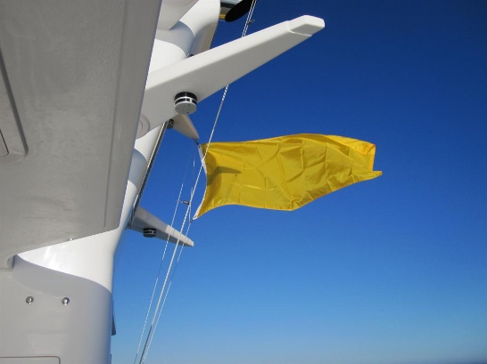
Yellow Quarantine Flag
If the ship is flying a Yellow Quarantine Flag, FGIS must not board the vessel unless authorized by Customs or Immigration. Check with the Agent.

Slide 5
Safe Gangway
Make sure the gangway is safe to use. Ensure proper netting is in place, and Rails and ropes are secure.

Slide 6
Not Safe Access
Notes:
Not safe access

Slide 7
Not Safe Access
Notes:
WALK THE PLANK MATEY! ARGH!
This is NOT safe entry!

Slide 8
Boarding – Sign In
Notes:
Sign in on deck. Show your Government ID. Ask to see the Captain and Agent

Slide 9
You are in the Captain's Country!
Notes:
Greet the Captain and present yourself in a professional manner.
We are now on his ship and in his country.

Slide 10
Opening Conference
Notes:
An opening conference will be held to explain to all party’s what your role is and what you will be doing.
Those at the table may be the Captain, NCB, Agent and FGIS.

Slide 11
Opening Conference
Notes:
The Agent will provide an Application with needed information:
The name of the ship and requested holds to look at.
The Applicants name, that FGIS will charge the inspection to.
The last 2 countries and cargos.
Go over the Bribe Sheet with the Captain. Make sure the holds you are going into are safe and have
Not been fumigated recently.

Slide 12
Opening Conference
The Agent will provide an Application with needed information:
The name of the ship and requested holds to look at.
The Applicants name, that FGIS will charge the inspection to.
The last 2 countries and cargos.
Go over the Bribe Sheet with the Captain. Make sure the holds you are going into are safe and have not been fumigated recently.
Notes:
The Agent will provide an Application with needed information:
The name of the ship and requested holds to look at.
The Applicants name, that FGIS will charge the inspection to.
The last 2 countries and cargos.
Go over the Bribe Sheet with the Captain. Make sure the holds you are going into are safe and have
Not been fumigated recently.

Slide 13
Safety
Ask the Captain to have 2 crew members go with you on the inspection.
One to go down with you into the hold
The other to stay on top to observe for safety reasons.

Slide 14
Safety
Be careful on deck. There can be many potential safety hazards.
Watch out for low hanging objects.
Be alert for moving chains and hatch covers.
Stay clear of ship ropes. They may tighten and loosen as the ship moves.

Slide 15
Safety – Heads Up!
Notes:
Be careful on deck. There can be many potential safety hazards.
Watch out for low hanging objects.
Be alert for moving chains and hatch covers.
Stay clear of ship ropes. They may tighten and loosen as the ship moves.

Slide 16
Safety – Trip / Slip Hazards
Notes:
Watch out for protruding objects on the deck. The deck may also be slick do to previous cargo or May be wet and oily. Watch out above for swinging ropes and cables.

Slide 17
Safety – Be Alert!
Before entering the hold, look over the side to get a good view from the top.
Look for any potential problem areas.
Previous cargo
Rust scale
Paint scale
Damage /water leaks.
NOTE: MAKE SURE THE CREW MEMBERS KNOW WHERE YOU ARE AT ALL TIMES!
** BE ALERT **

Slide 18
Safety
Notes:
Before entering the hold, look over the side to get a good view from the top.
Look for any potential problem areas.
Previous cargo
Rust scale
Paint scale
Damage /water leaks.
NOTE: MAKE SURE THE CREW MEMBERS KNOW WHERE YOU ARE AT ALL TIMES!
** BE ALERT **

Slide 19
Hatch Covers
Notes:
While on deck check the hatch covers and rails for previous cargo and rust scale.

Slide 20
Hatch Covers - Rust
Notes:
Rust Scale

Slide 21
Hold Entry – Pin the Lid
Notes:
Make sure the man hole entry lid is pined before entering the hold.
This ensures the lid will not come down on you as you enter.

Slide 22
Hold Entry – Follow
Notes:
Have the crew member enter the hold first. If something is amiss, he will be able to point it out.

Slide 23
Previous Cargo
Notes:
Check Places where previous cargo may be.

Slide 24
Previous Cargo
Notes:
Cleaning ledges of previous cargo.

Slide 25
Previous Cargo
Notes:
Cleaning ledges of previous cargo.

Slide 26
Previous Cargo

Slide 27
Previous Cargo

Slide 28
Exit Conference
Notes:
Once the inspection is complete, fill out the Stowage Examination Worksheet.
Make sure the holds that failed are on a separate Worksheet from the passed holds.
Give the top 2 copies to the Agent and Captain.

Slide 29
Exit Conference
Once the inspection is complete, fill out the Stowage Examination Worksheet.
Make sure the holds that failed are on a separate Worksheet from the passed holds.
Give the top 2 copies to the Agent and Captain.

Slide 30
Welcome Home!
Notes:
Exit the Ship once the service is complete.

Slide 31
Summary
This presentation covered the process of Shiphold Stowage exams.
Pictures were provided to help orient you to the procedure.

Slide 32
Conclusion
If you have questions please see your Supervisor or Training Officer

